Slide 1
SOUND BAR CATEGORY CLUSTERING - PREDICTION AND ANALYSIS
PRESENTED BY
VEENA SRI PM
DATA ANALYTICS AND DATA SCIENCE
RP 33
21-07-2025

Slide 2
OBJECTIVE
To develop a system for soundbar products by leveraging web-scraped data stored in a MySQL database, applying unsupervised learning for automated classification and market segmentation, also perform supervised learning to accurately predict product categories.
DATA COLLECTION
Product - Sound Bars
Source - Amazon (E-commerce website)
Features - Name, Brand, Price, Ratings, Reviews
Data scrapped - 2860 rows
Data converted to CSV file

Slide 3
DATA CLEANING
Removed missing values
Eliminated duplicate rows
Text Preprocessing - regular expression
Extracted numeric rating from string
Data Type Conversion
Dropping unnecessary columns
Checked outliers

Slide 4
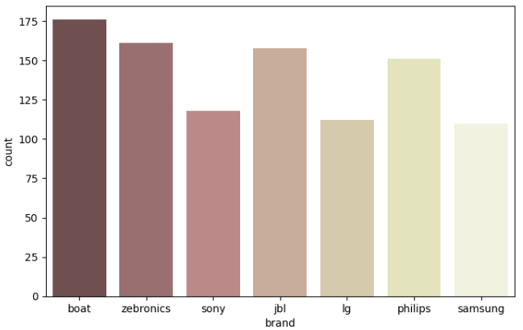
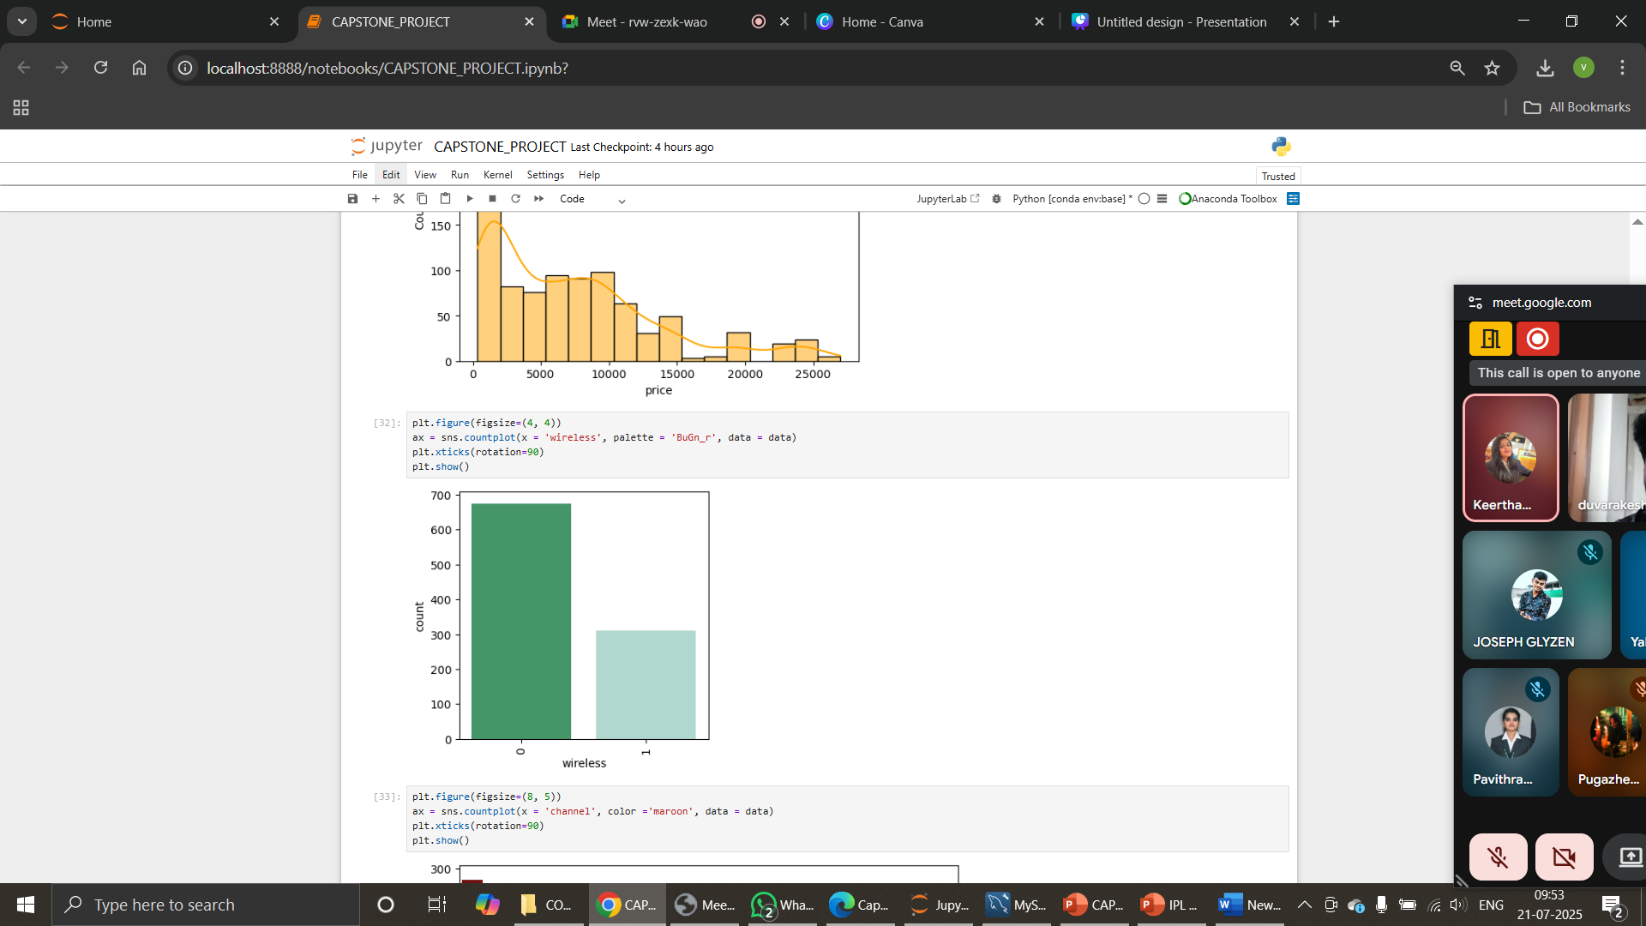
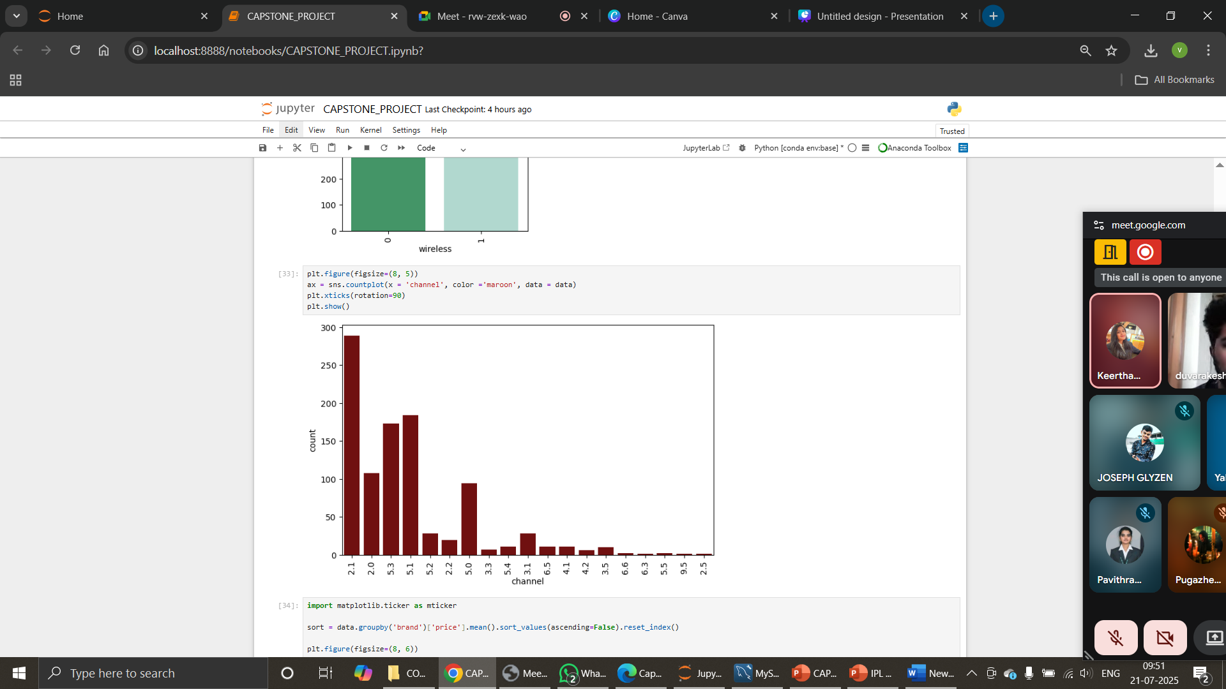
EXPLORATORY DATA ANALYSIS
UNIVARIATE ANALYSIS

Slide 5
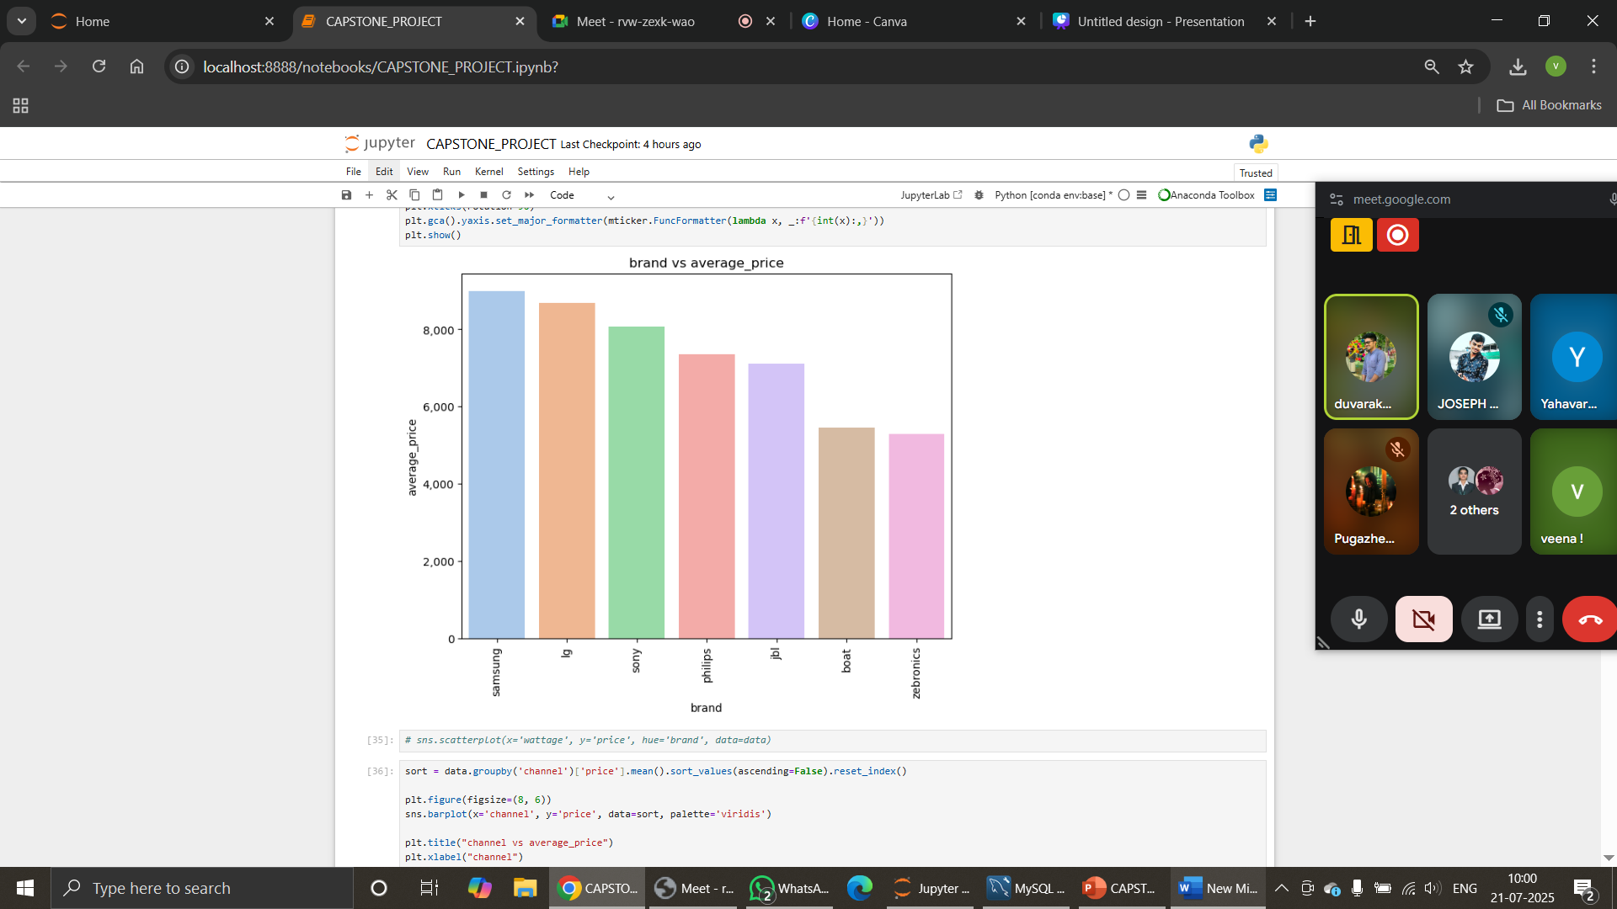
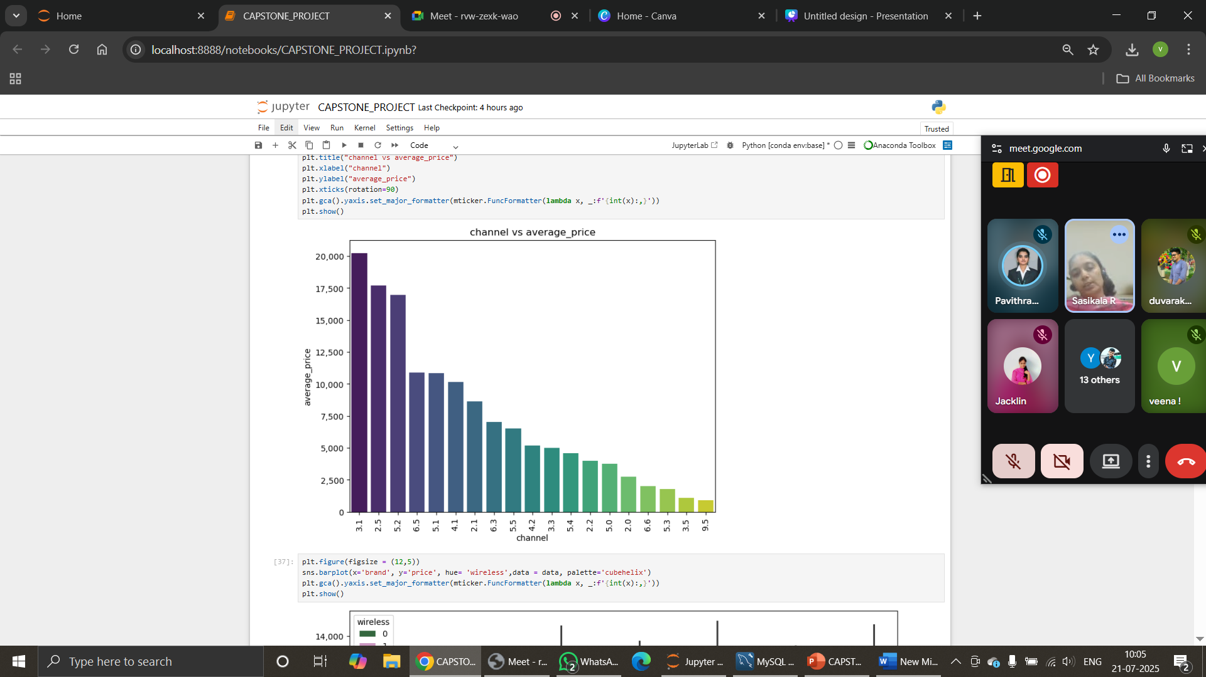
BIVARIATE ANALYSIS

Slide 6
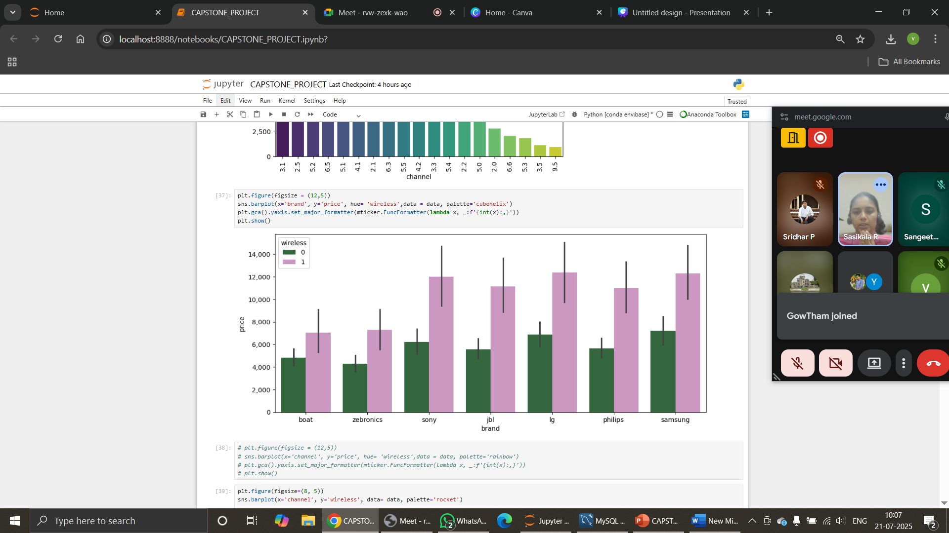
MULTIVARIATE ANALYSIS
Wireless models influences Price
Brands like Sony, LG, Samsung dominate in wired soundbars

Slide 7
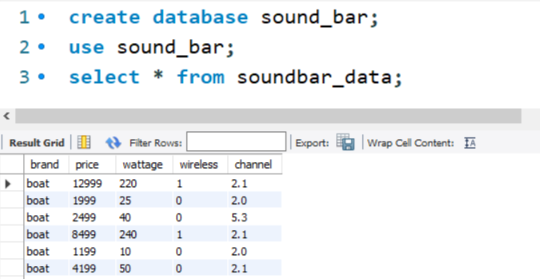
DATA STORAGE
Structured data stored in MySQL Database
Created - Database and Table
Performed a query to fetch all details from the table
Result stored as a Data Frame
Retrieved - further analysis
DATA PREPROCESSING
Label Encoding
Scaling - StandardScalar
Dropped columns to avoid redundancy

Slide 8
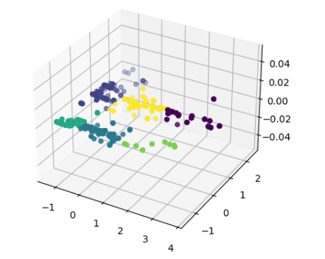
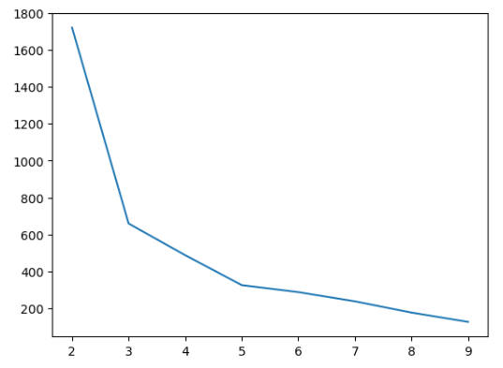
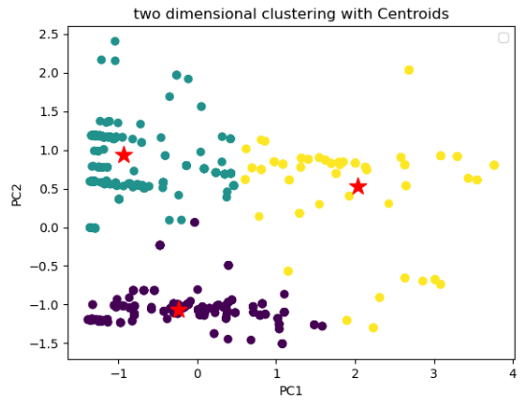
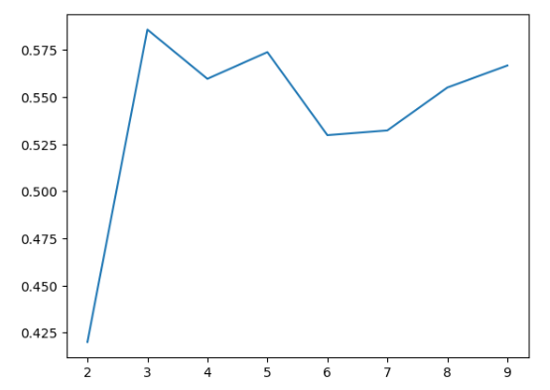
CLUSTERING
Principle component analysis
Dimension reduced – PCA1, PCA2
Visualized 3D clusters
KMeans Clustering
Optimal K using Elbow = 3 and Silhouette = 3
Silhouette score = 0.585
Grouped - three clusters
Cluster column concatenated with Data Frame

Slide 9
SUPERVISED LEARNING
Predict product category
Price, Wattage, Wireless, Channel
Preprocessing – Standardscalar, Label encoding, Sampling
Logistic Regression, KNN, SVM, Naive Bayes, Decision Tree, Random Forest, XGBoost
Evaluation metrics, CrossValidation - performed
Hyperparameter tuning - best parameters

Slide 10
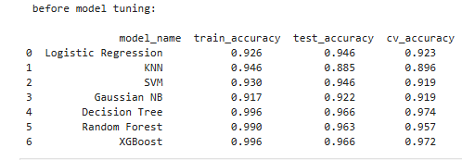
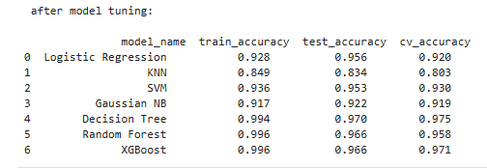
COMPARING ACCURACY
BEFORE TUNING WITHOUT SAMPLING:
Higher accuracy
XGBoost
Decision Tree
Random Forest
AFTER TUNING WITHOUT SAMPLING:
After tuning - Accuracy
XGBoost
Decision Tree
Random Forest

Slide 11
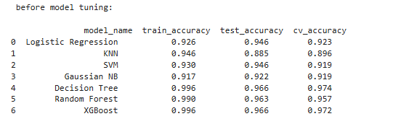
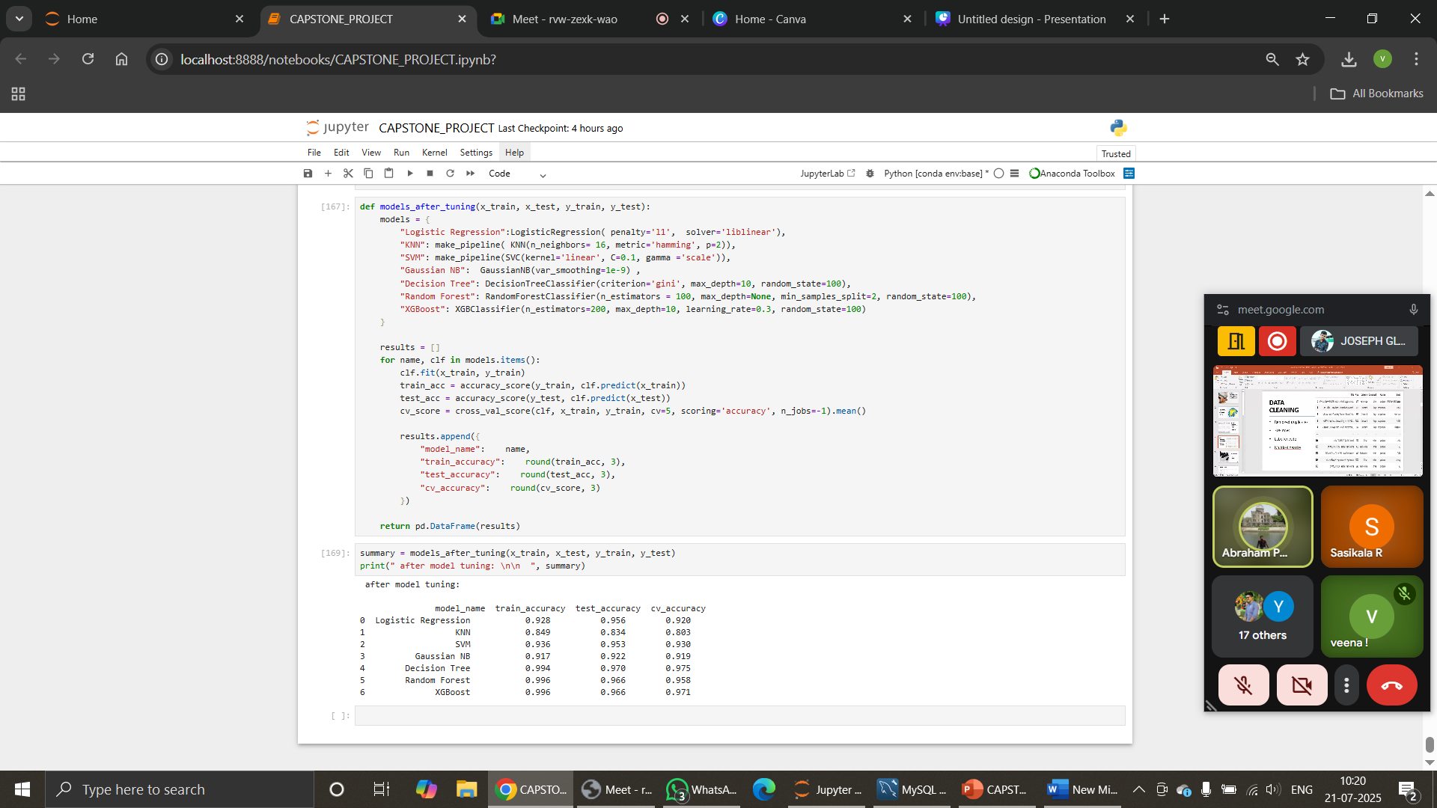
COMPARING ACCURACY
BEFORE TUNING WITH SAMPLING:
Higher accuracy
XGBoost
Decision Tree
Random Forest
AFTER TUNING WITH SAMPLING:
After tuning - Accuracy
XGBoost
Decision Tree
Random Forest

Slide 12
CONCLUSION
Meaningful product grouping using PCA for better clustering
Soundbar product classification and prediction performed
Enabled data-driven market segmentation for consumer electronics
Helps manufacturer in product categorization and recommendation systems
FUTURE SCOPE:
Integrate sentiment analysis from reviews
Deploy model as a recommendation engine

Slide 13
THANK YOU

